Slide 1
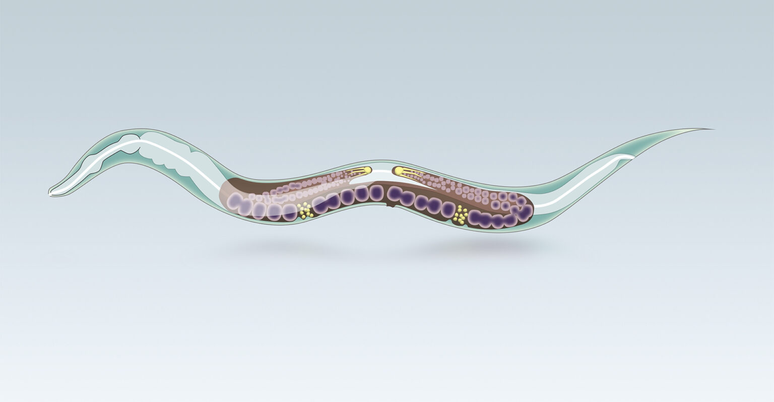



AFOXOLANER AND FLURALANER AS POTENTIAL ANTINEMATODAL AGENTS
Dragana Medić
Teaching assistant
Faculty of veterinary medicine
University of Belgrade, Serbia

Slide 2
Conflict of Interest
The authors declare no conflicts of interest.
Funding
This research was supported by the Science Fund of the Republic of Serbia through the PRISMA Programme, under the project:
“Investigation of Anthelmintic Targets in the Neuromuscular System of Parasitic Nematodes for the Improvement of Pharmacotherapy and Development of Novel Drugs”
Grant Agreement No. 5021/2023.

Slide 3
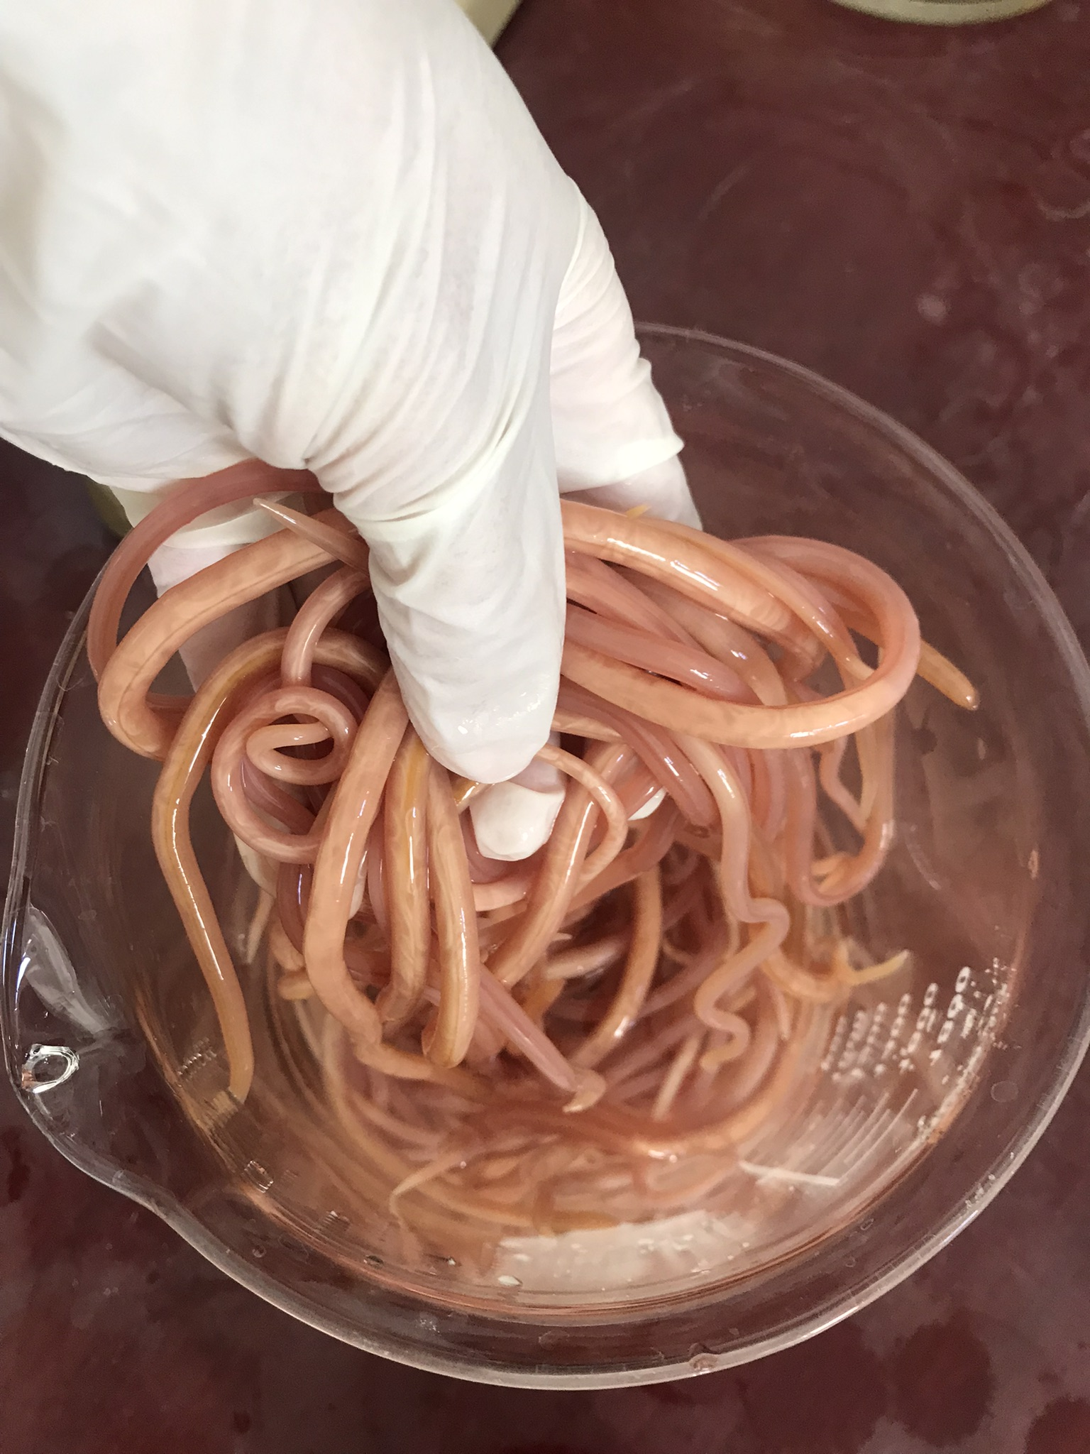
Introduction
Anthelmintic resistance is an increasing global problem
Only a few new anthelmintic classes have been introduced in the last 25 years
Drug repurposing offers a promising strategy for novel therapies
Nematode neuromuscular transmission is a major pharmacological target

Slide 4
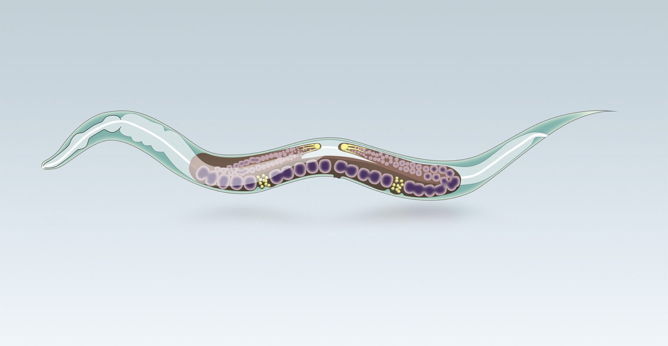
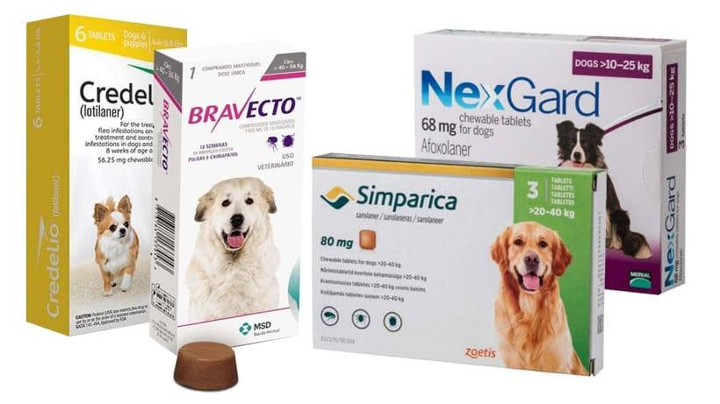
Isoxazolines – ectoparasiticides (fleas and ticks)
Afoxolaner and fluralaner
  ligand-gated chloride channels,
  particularly GABA-gated channels
High potency and selectivity
Established safety profile
GABA receptor modulation
Neuromuscular dysfunction
Isoxazolines
Antiparasitic effect

Slide 5
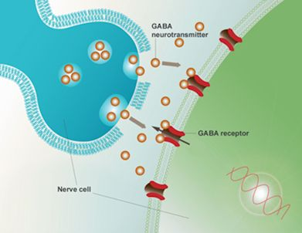
GABA gated ion-channel structure - 5 subunits
Extracellular side
GABA receptors underexplored in nematodes
Cl⁻
Cl⁻
GABA
Cl⁻
Cl⁻
GABA
Piperazin
Piperazin
UNC
49B
UNC
49B
UNC
49A
UNC
49B
UNC
49C
HYPEROLARIZATION
Ion channel
GABA receptors regulate inhibitory neurotransmission in nematodes.
Activation → muscle relaxation and flaccid paralysis.
Cl⁻
Cl⁻
Cl-
Cl⁻
Cl’
Cl⁻
Intracellular side

Slide 6


Aim of the study
Evaluate the effects of afoxolaner and fluralaner on:
Caenorhabditis elegans development and motility
Ascaris suum neuromuscular contractions and relaxation
GABA receptor interactions using molecular docking

Slide 7

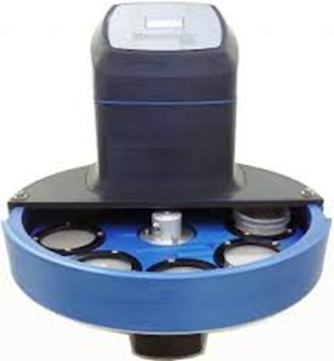
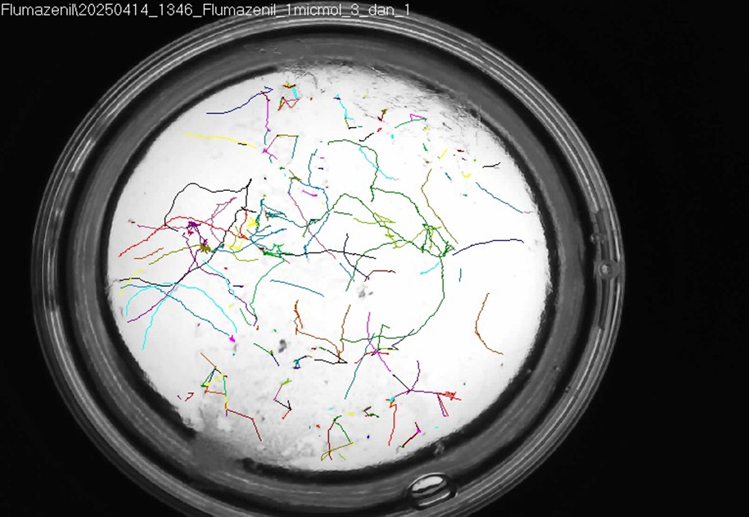
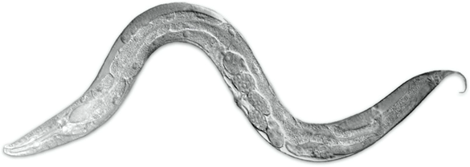
C. elegans assay
  Exposure to 1, 3 and 10 μM afoxolaner
  Observation for 48h
  Microtracker SMART 8
Measured:
  number of adults
  distance travelled
  movement speed
  motility score

Slide 8
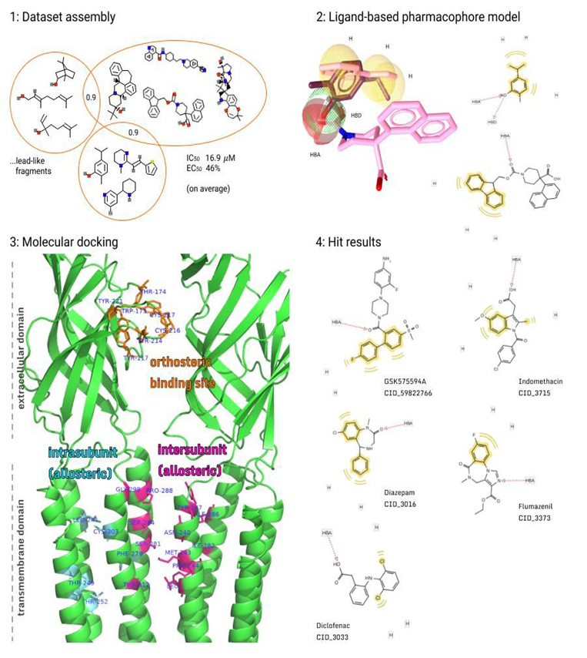
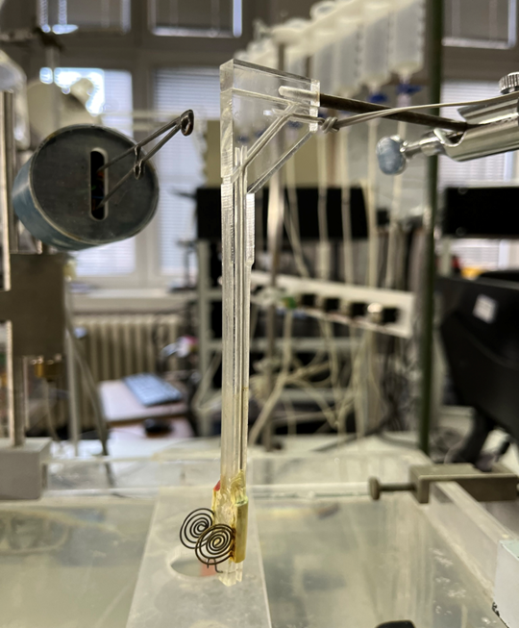
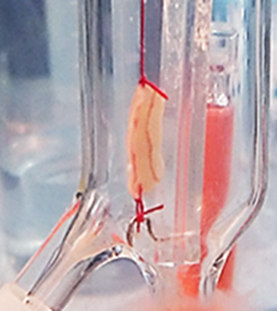
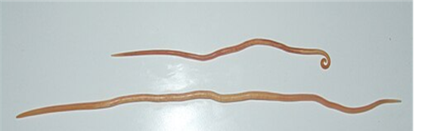
In silico isoxazoline pharmacology at invertebrate GABA receptor models
A. suum assay
Neuromuscular preparation
ACh-induced isometric contractions
GABA-induced relaxation
Testing afoxolaner ± GABA ± piperazine
Receptor sequence retrieval from public databases
Homology modelling (SWISS-MODEL, Phyre2.2)
Molecular docking simulations of ligand–receptor interactions

Slide 9
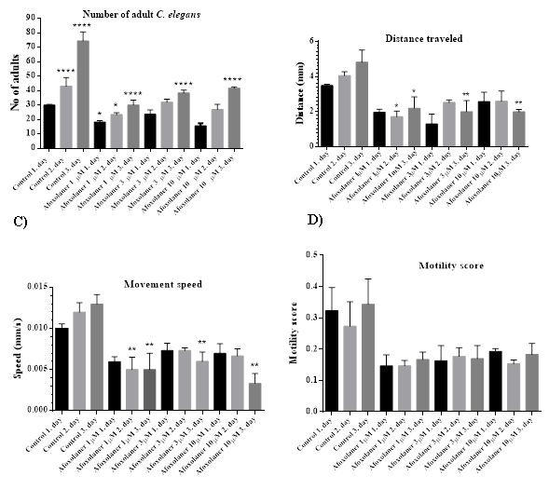
Results
Effect on C. elegans
Afoxolaner inhibits development and reduces motility
No lethal effect observed
Fewer adult worms developed
Significant reduction in:
  distance travelled
  movement speed
Overall motility decreased

Slide 10
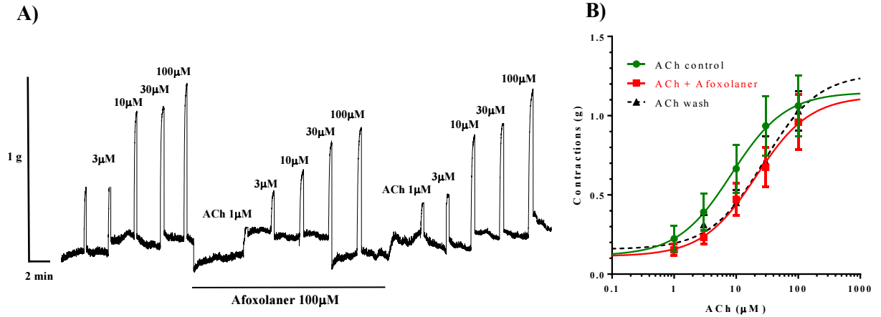
Influence of afoxolaner on the contraction/relaxation of neuromuscular preparation A. suum
Effect of afoxolaner on ACh-induced contractions
ACh-induced contractions
Afoxolaner increased EC50 of acetylcholine
Maximal contraction remained unchanged, suggests competitive antagonism-like effect on cholinergic responses

Slide 11
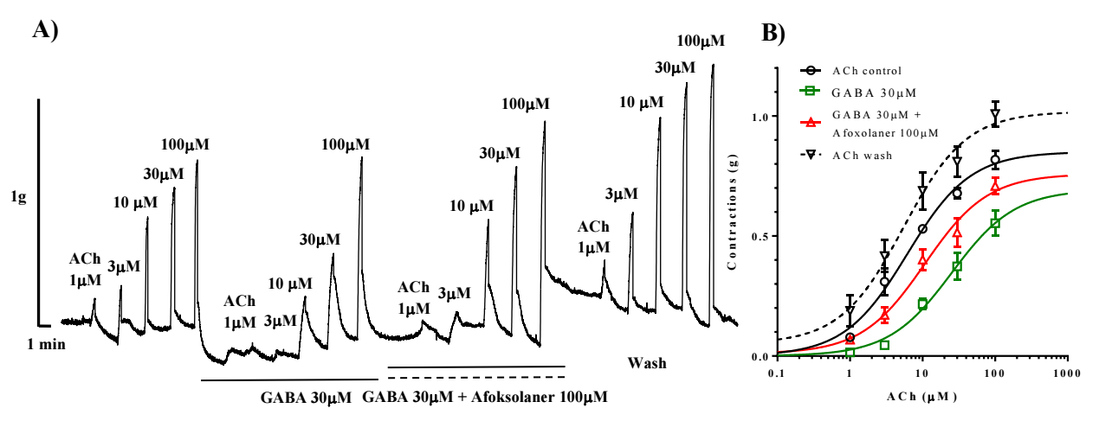
Effect of GABA and afoxolaner on ACh-induced contractions
ACh-induced contractions
GABA inhibited ACh-induced contractions:
    30 µm GABA increased the EC50 of ACh
Afoxolaner modified this response:
    100μM afoxolaner reduced the inhibitory effect of GABA

Slide 12
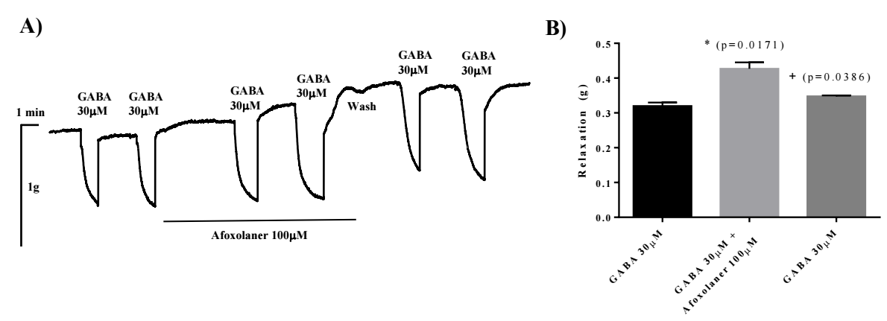
Relaxant effect of GABA, afoxolaner and piperazine
Afoxolaner potentiates GABA-induced relaxation
GABA (30 μM) induced reproducible relaxation of Ascaris suum muscle
Afoxolaner (100 μM) significantly enhanced GABA-induced relaxation
The potentiating effect was reversible, as responses returned to baseline after washout

Slide 13
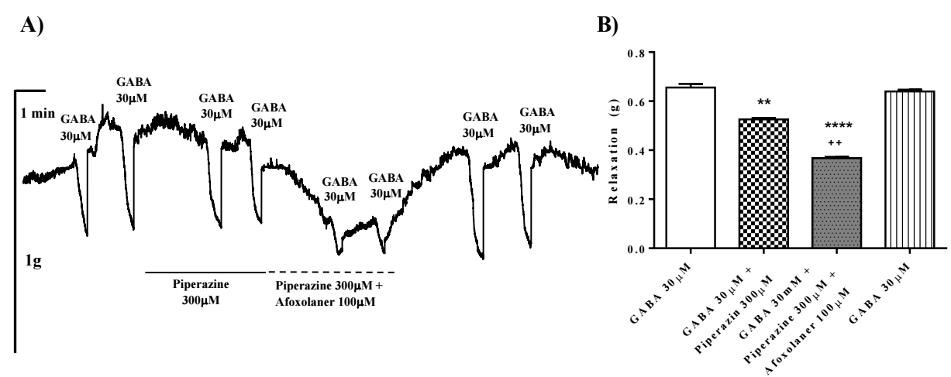
Interaction between piperazine and afoxolaner
GABA-induced relaxation
Piperazine (300 μM) significantly reduced GABA-induced relaxation compared with control
Co-application of afoxolaner and piperazine produced an even greater inhibition of GABA-induced relaxation

Slide 14
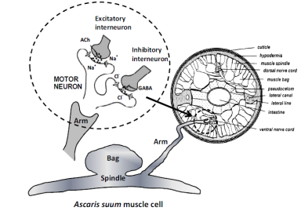

Synaptic GABA receptor
GABA
Cl-
Cl-
Extrasynaptic GABA receptor
AFOXOLANER

Slide 15
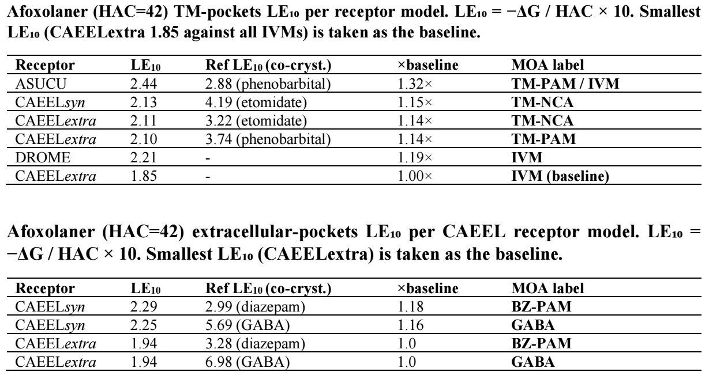
Molecular docking

Slide 16
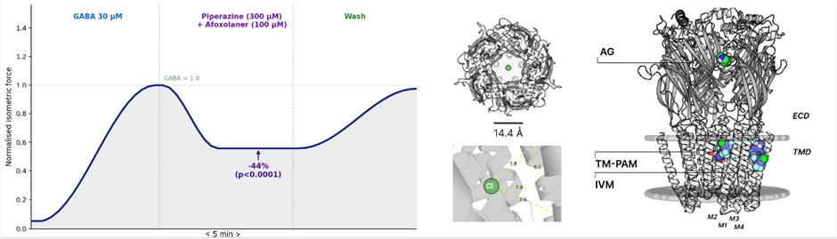
Molecular docking
Piperazine preferentially binds the orthosteric GABA site
Afoxolaner preferentially occupies allosteric transmembrane pockets
Computational findings support experimental observations

Slide 17
Conclusions
Afoxolaner shows promising antinematodal activity by affecting development and motility in C. elegans, antagonizing acetylcholine (ACh)-induced contractions, and enhancing the relaxant effects of GABA in A. suum.

Slide 18
Conclusions
Its pharmacological action on GABA receptors appears to be dual:
During ACh-induced contractions, afoxolaner behaves as a partial agonist/antagonist of GABA receptors, likely involving binding to an orthosteric site and affecting synaptic GABA receptors between interneurons and motoneurons.
During GABA-mediated relaxation via extrasynaptic receptors, it acts as a positive allosteric modulator (PAM), enhancing GABA activity without inducing relaxation on its own, and antagonizing piperazine effects.
    These dual actions on synaptic and extrasynaptic GABA receptors suggest an important role in its antinematodal activity and warrant further investigation.
    However, potential interactions with GABAergic anthelmintics (GABA receptor agonists) used in combination therapies should be carefully considered.

Slide 19





Acknowledgement to the research team of the Department of Pharmacology and Toxicology, Faculty of Veterinary Medicine in Belgrade
Saša M. Trailović,
DVM, PhD
Professor
Djordje S. Marjanović,
DVM, PhD
Assistant professor
Dragana Medić,
DVM
Teaching assitant
Tihomir Marić,
DVM
Research Associate
Strahinja Stevanović,
PhD
Research Associate

Slide 20
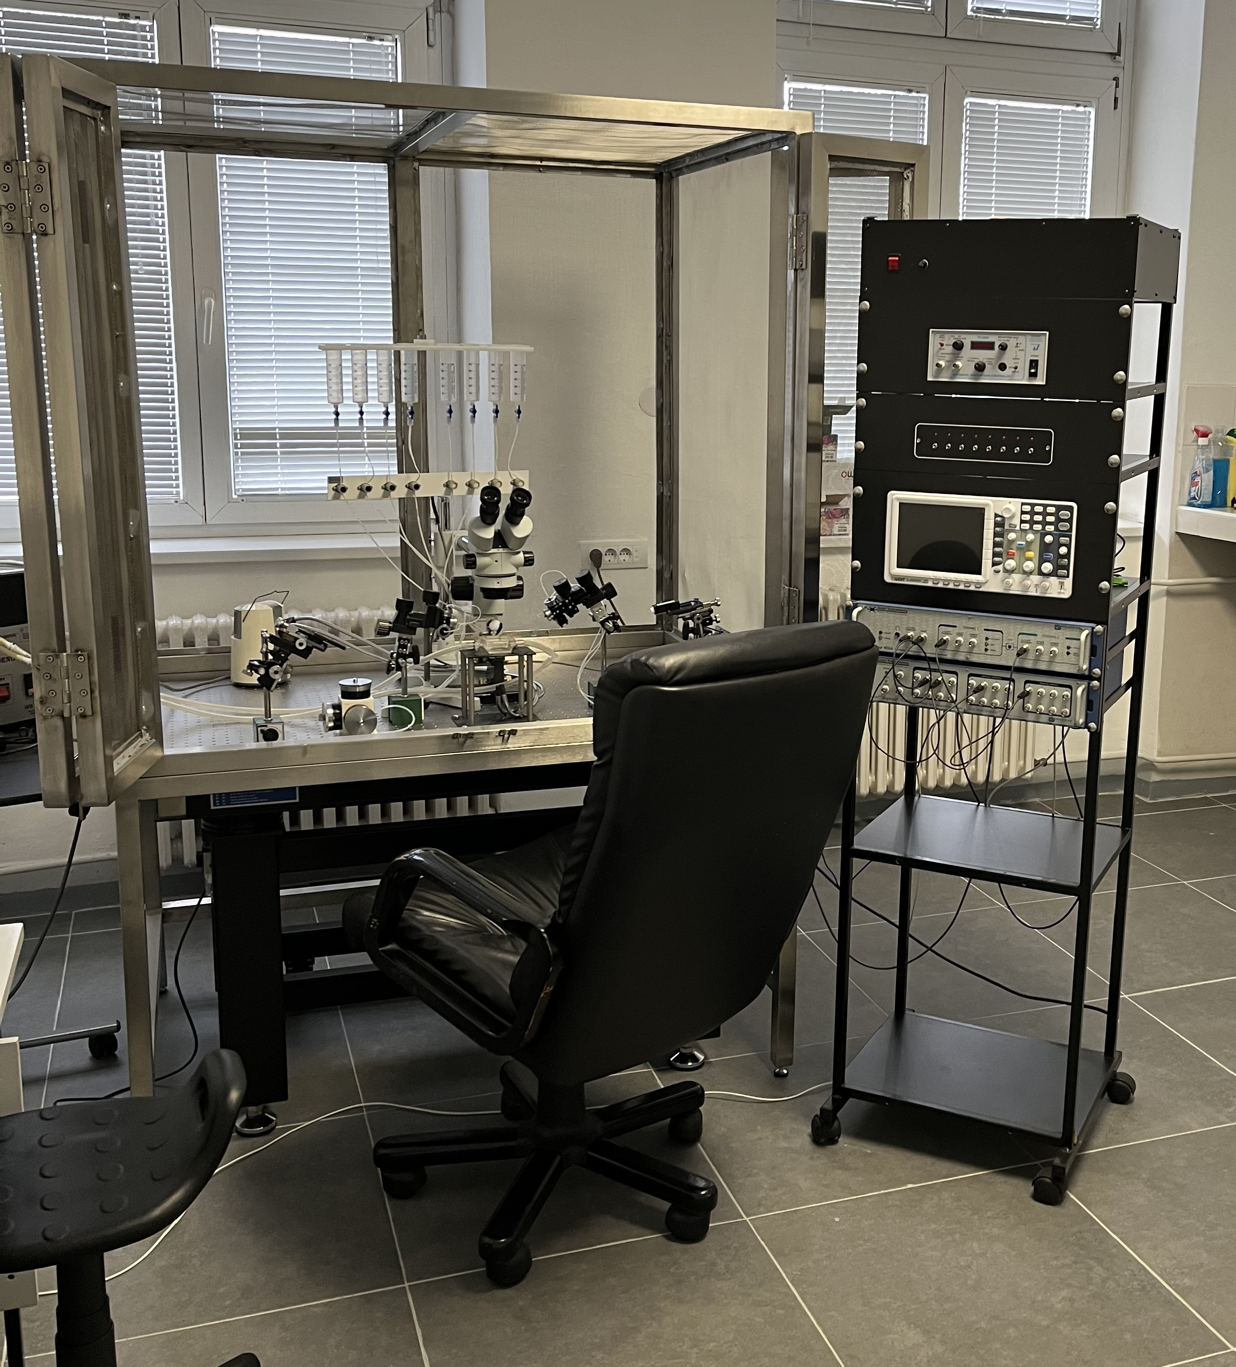
Thank you for your attention

